Slide 1


Cu Chi People’s Committee
Phu Hoa Dong Primary School
Online English Learning Chanel

Slide 2

Family and Friends
Special Edition
Grade 5
Ms Danh

Slide 3
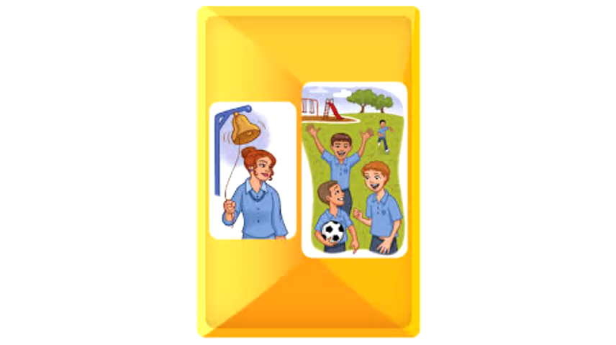

Slide 4


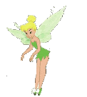

REVIEW 2
P. 48

Slide 5
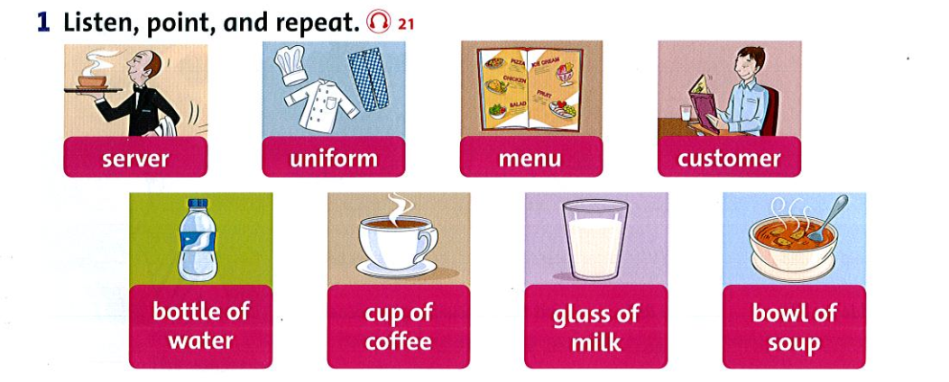

Slide 6
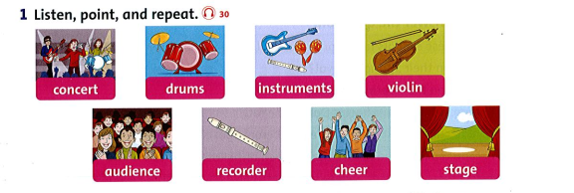

Slide 7
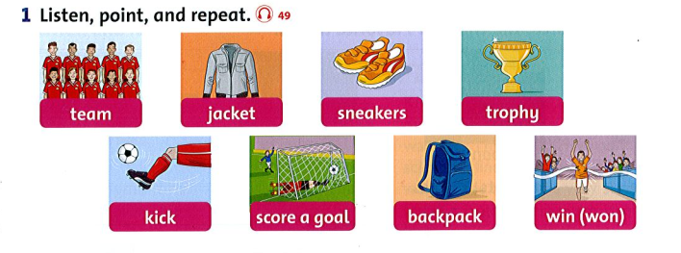

Slide 8


Grade 5
2

Slide 9
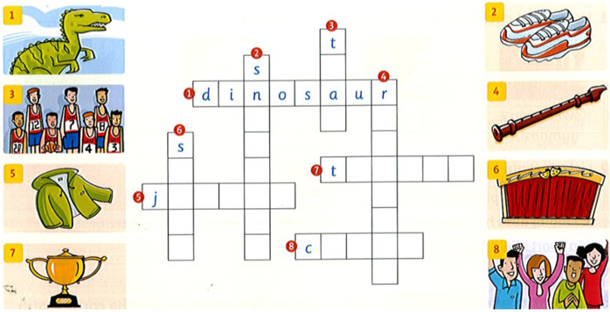
Complete the crossword

Slide 10
Complete the crossword
e
e
m
e
a
c
t
k
r
o
p
h
y
a
c
k
e
t
r
g
r
d
e
s
h
e
e
r
r

Slide 11
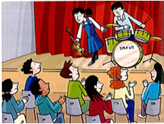
Write: cheered concert drums violin stage audience
Emily and Joe are both ten. On Wednesdays they go to music lessons. Emily is learning the ¹_violin_ and Joe is learning the ²____ . Last week they performed in a ³_____ at the music at school. Emily went up on the ⁴_____ first. Then it was time for Joe. They were nervous, but they played well. The ⁵______ clapped and ⁶______ . Emily and Joe were very proud.
drums
concert
stage
audience
cheered

Slide 12

GAME TIME

Slide 13

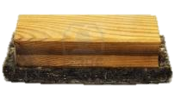
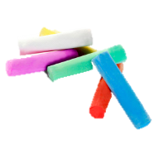
GRAMMAR – PAST SIMPLE
PRACTICE
Did she sing a song last night?
No, she didn’t.
What did she do?
She clapped her hands.

Slide 14

GRAMMAR – PAST SIMPLE
PRACTICE
Did they talk a lot yesterday?
Yes, they did.

Slide 15

GRAMMAR – PAST SIMPLE
PRACTICE
Did he drive a car last Sunday?
No, he didn’t.
What did he do?
He ran to the park.

Slide 16
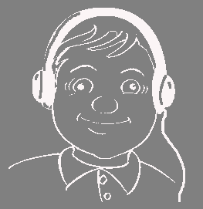
GRAMMAR – PAST SIMPLE
PRACTICE
Did he do homework yesterday evening?
No, he didn’t.
What did he do?
He listened to music.

Slide 17

GRAMMAR – PAST SIMPLE
PRACTICE
Did he sing a song two days ago?
Yes, he did.

Slide 18

GRAMMAR – PAST SIMPLE
PRACTICE
Did he eat dinner with his friends last night?
No, he didn’t.
What did he do?
He drank beer.

Slide 19

GRAMMAR – PAST SIMPLE
PRACTICE
Did he write an email yesterday?
No, he didn’t.
What did he do?
He drove a car.

Slide 20

GRAMMAR – PAST SIMPLE
PRACTICE
Did he play soccer last weekend?
Yes, he did.

Slide 21

GRAMMAR – PAST SIMPLE
PRACTICE
Did he sleep yesterday?
No, he didn’t.
What did he do?
He swam in the pool.

Slide 22
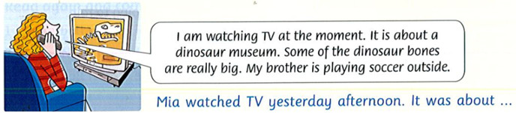
Read. Then write what Mia did yesterday afternoon.

Slide 23
Match the question with the answer.
a. Yes, I ate dinner at home.
1. Where did you go yesterday?
2. What did you see?
3. Did you buy anything there?
4. Did you eat after the movie?
5. What did you think of the movie?
b. I went to the movies.
c. I thought it was great.
d. I saw a movie about tigers.
e. Yes, I bought a drink.

Slide 24
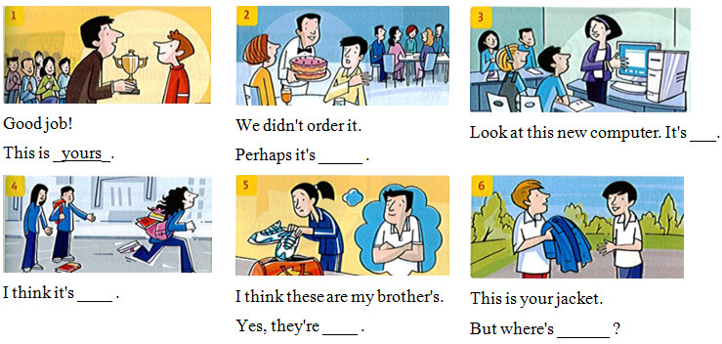
Write: hers theirs mine yours ours his
yours
theirs
hers
his
mine

Slide 25
Write the words under the correct sounds
blue light bike coat sky nose room flute blow
Long i bike | Long o | Long u

Slide 26
Write the words under the correct sounds
blue light bike coat sky nose room flute blow
Long i Bike Light Sky | Long o Coat Nose Blow | Long u Blue Room flute

Slide 27
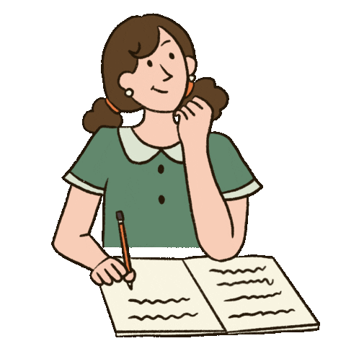
WORKBOOK
PAGE 46-47

Slide 28
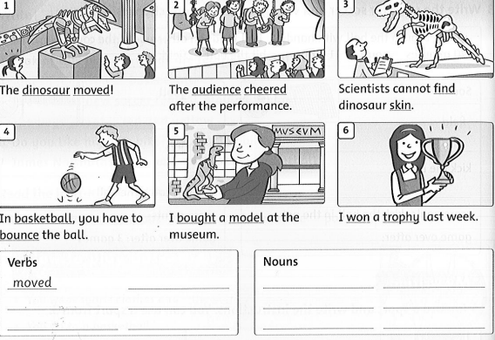
bounce
dinosaur
basketball
cheered
bought
audience
model
find
won
skin
trophy

Slide 29
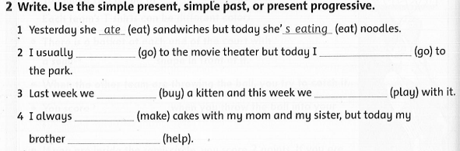
go
am going
bought
play
make
is helping

Slide 30
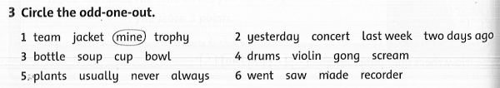

Slide 31
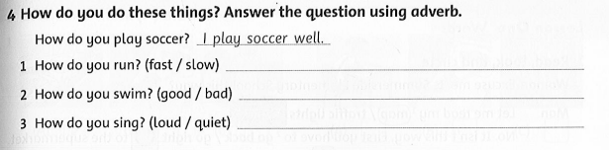
I run fast.
I swim very well.
I sing loudly.

Slide 32
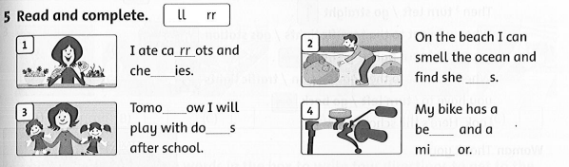
rr
ll
ll
ll
rr

Slide 33
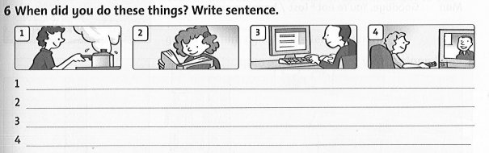
I cooked yesterday.
I read books last night.
I used the computer two days ago.
I watched TV last week.

Slide 34
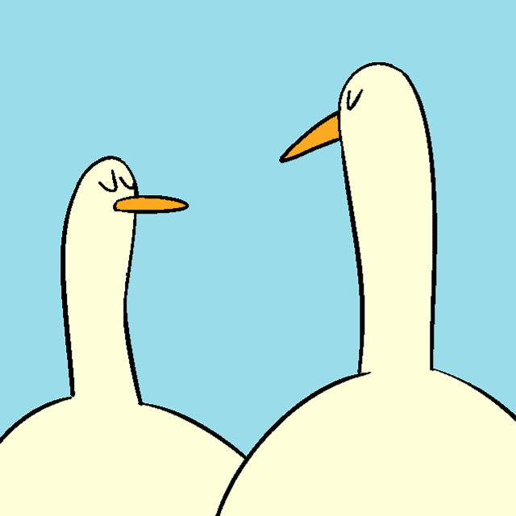
GOODBYE!!!

